Slide 1
Agile Project Management - Final Project
Msmsd 5213

Slide 2

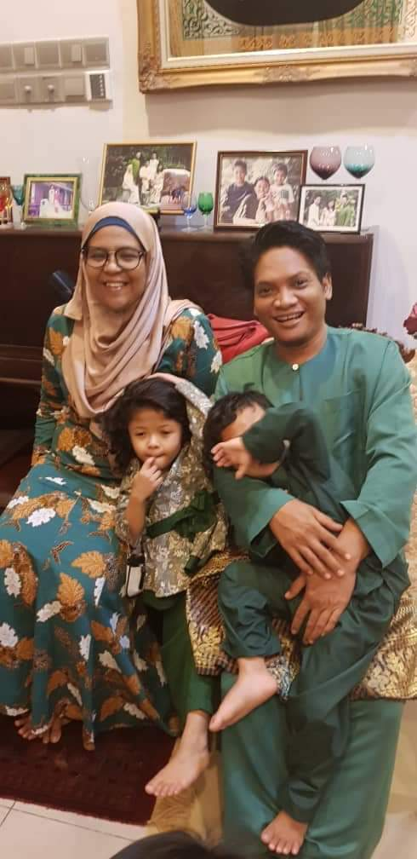
Team Member
UMMI IZZATI BINTI MUSTAPHA
MASTER OF SOFTWARE ENGINEERING (MOBILE DEVELOPMENT)
NIK INTAN HAZURA BINTI N ABDUL HALIM
MASTER OF SOFTWARE ENGINEERING (MOBILE DEVELOPMENT)

Slide 3
Project Proposal
Project Name
How tools contribute toward Agile Project Management
Scope
To share the experience of using Agile methodology via a short video.
Proposal
Using GitHub Project as tools
All project task and documentation recorded and added in tools
Benefits
Effective handling for project and releases
Well organized project and implementation
Familiarization to GitHub

Slide 4
Project Vision
Vision :
For all student that want to have fast and easy setup of project management that have flexibility arrangement. We Master Agile team will share a solution using a tools that can increase software quality using agile project management.
Notes:
Target Group : For all student
Needs : Fast and easy setup of PM, have flexibility,
Team : Master Agile team
Value : increase software quality

Slide 5
Agile Project Lifecycle
Planning
Schedule/Time
List all the backlog
Iteration Planning
Prioritize backlog of a daily work
Daily Work
Checking on issue or impediment
Review
Project Vision
Task Completion
Task review
Project closure
Retrospective
Quality check

Slide 6

Video Demo

